Slide 1
MINES-VIS
Week 1

Slide 2
Minor Embedded Systems
Modules
MINES-ROB: Robotics
Advanced Control: learn to realize intelligent behavior
MINES-VIS: Vision
Advanced Sensing: learn to extract information from camera images. You will not learn how to program in C++ or other languages
MINES-CON: Connectivity
Advanced Connectivity: learn to apply adhoc wireless networking
MINES-INNO: Innovations in Embedded Systems
Research: learn to investigate new ES technology
Projects
MINES-PROJ: Project ES

Slide 3
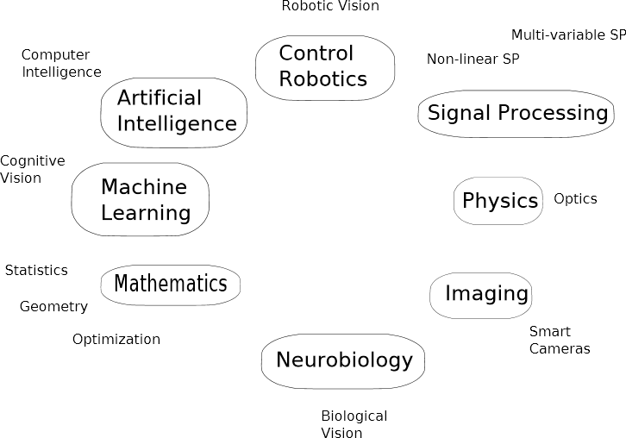
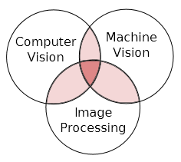
Connections to other disciplines

Slide 4
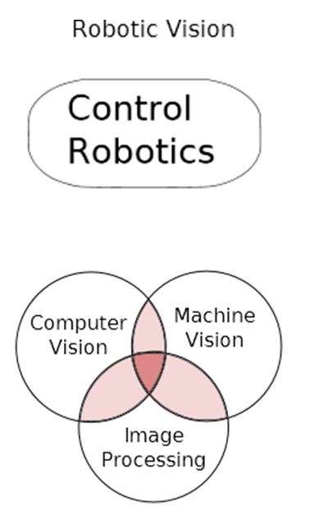
Project ES example
Where am I
where are you
Robot a definition:
A goal oriented machine that can sense, plan and act.
How do I get there?

Slide 5
TOPICS in brief week 1
Topics
Image sensing & Acquisition
Representing digital image(greyscale)
Image processing,
Histograms,
Thresholds,
Smoothing, blurring,
Blobs, area and centroid

Slide 6
Recommended reading:
Learning OpenCV Computer Vision with the OpenCV Library. Gary Bradski & Adrian Kaehler ISBN: 978-0-596-51613-0
Computer Vision Algorithms and Applications. Richard Szeliski. ISBN: 978-1-84882-935-0
Digital Image Processing. Rafael C. Gonzalez & Richard E. Woods ISBN:978-0-13-168728-8
Machine Vision: Automated Visual Inspection and Robot Vision” http://homepages.inf.ed.ac.uk/rbf/BOOKS/VERNON/

Slide 7
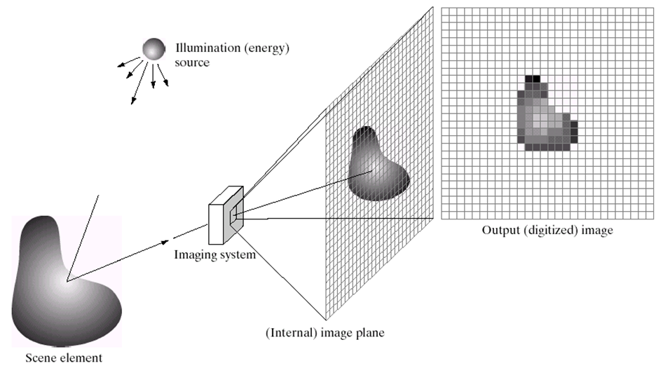
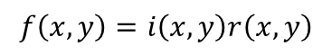
Image Acquisition and Formation Model
A digital image is a representation of a two-dimensional image as a finite set of digital values, called picture elements or pixels.
$$f\left(x,y\right)=i\left(x,y\right)r\left(x,y\right)$$
Notes:
Illumination and Reflection

Slide 8
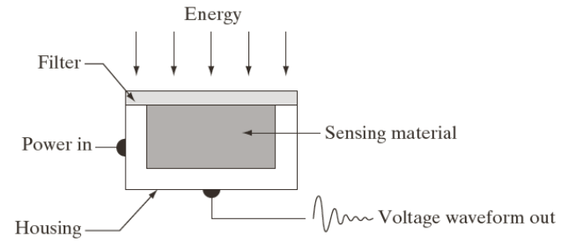

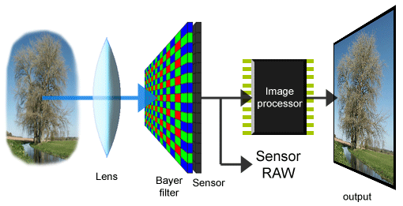
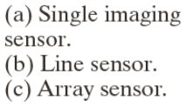
Image Sensing and Acquisition

Slide 9
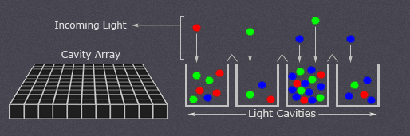
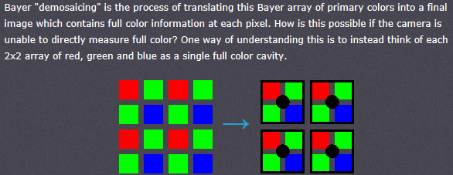
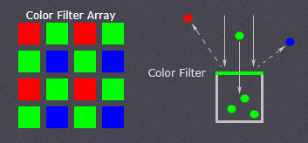
Image Sensing and Acquisition
( Filter)
The relative quantity of photons in each cavity are sorted into various intensity levels, whose precision is determined by bit depth (0 - 255 for an 8-bit image).
Each cavity is unable to distinguish how much of each color has fallen in, so the above illustration would only be able to create grayscale images.
A Bayer(color filter) array consists of alternating rows of red-green and green-blue filters

Slide 10
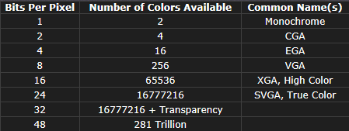
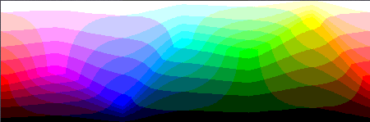
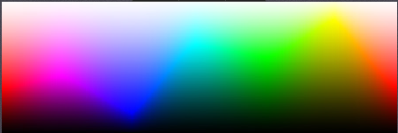
Image Sensing and Acquisition
BIT DEPTH
Bit depth quantifies how many unique colors are available in an image's color palette in terms of the number of 0's and 1's, or "bits," which are used to specify each color
Every color pixel in a digital image is created through some combination of the three primary colors: red, green, and blue.
8 bits
24 bits

Slide 11
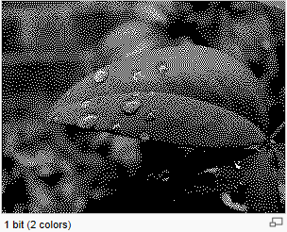
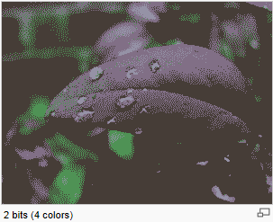
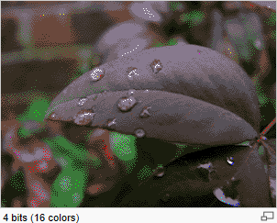
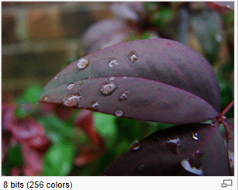
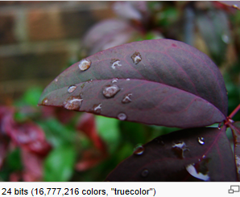
Image Sensing and Acquisition
BIT DEPTH

Slide 12

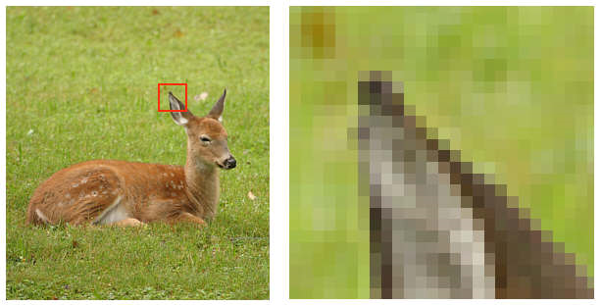
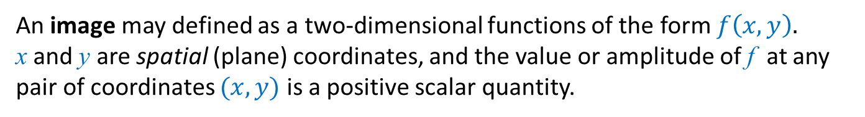
Image Acquisition and Formation Model
An image may defined as a two-dimensional functions of the form $f\left(x,y\right)$.
x and y are spatial (plane) coordinates, and the value or amplitude of f at any pair of coordinates $(x,y)$ is a positive scalar quantity.
Pixel values typically represent gray levels, colours, heights, opacities etc.
Remember digitization implies that a digital image is an approximation of a real scene
1 pixel
Result of image sampling and quantization

Slide 13

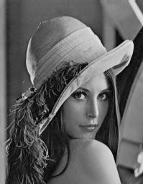
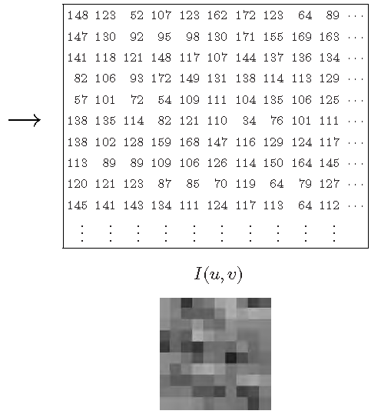
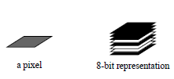
Representing Digital images
F(u,v)
A beginners guide to bitmaps: http://paulbourke.net/dataformats/bitmaps/

Slide 14
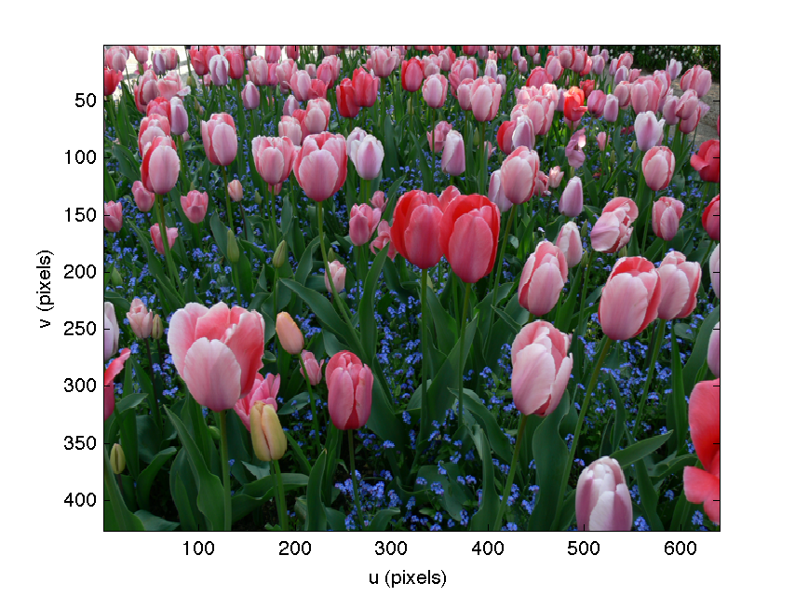
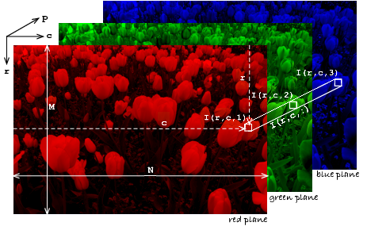
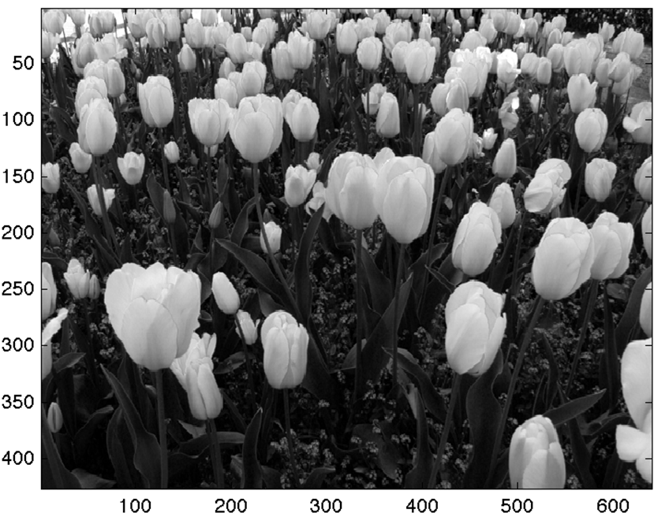
Representing Digital images

Slide 15
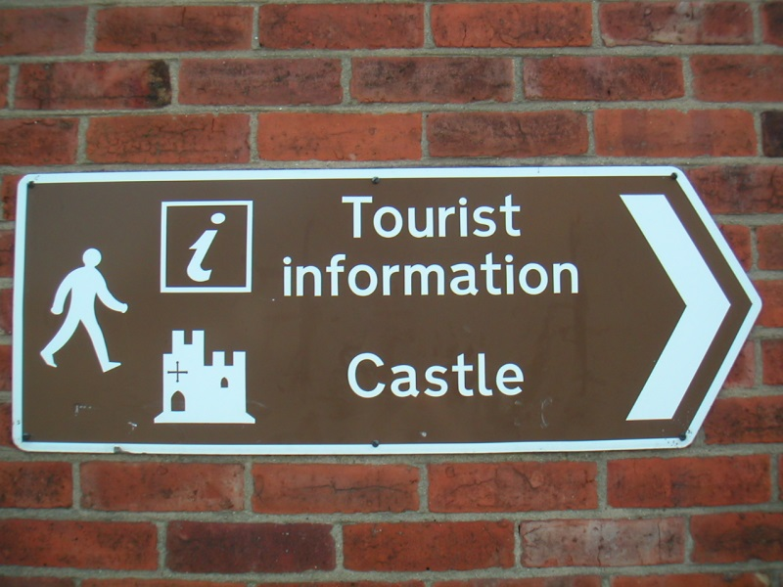
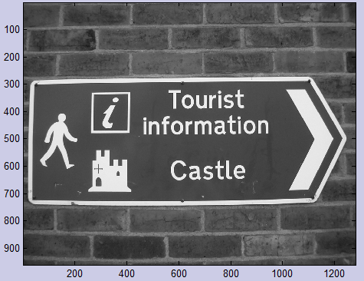
Representing Digital images
With OpenCV:
Mat img = imread(filename, 0);
Original image
Greyscaled image

Slide 16
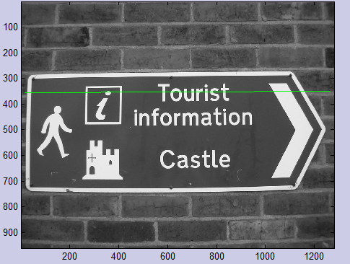
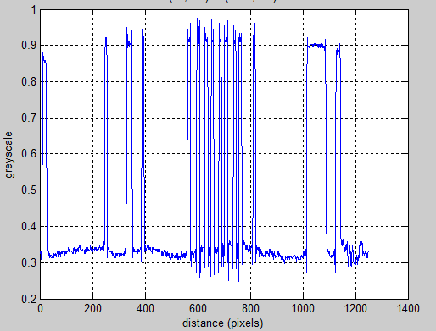
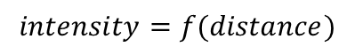
The intensity function
$$intensity=f(distance)$$

Slide 17
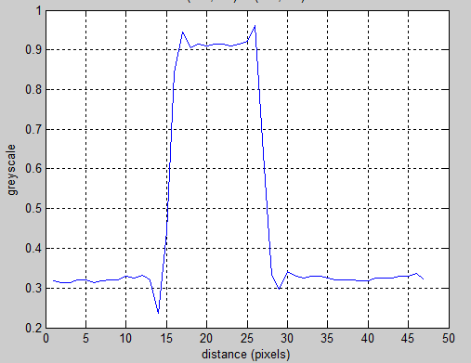
Representing Digital images

Slide 18
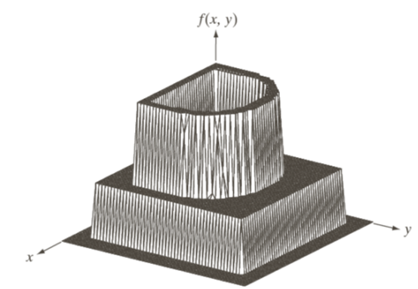
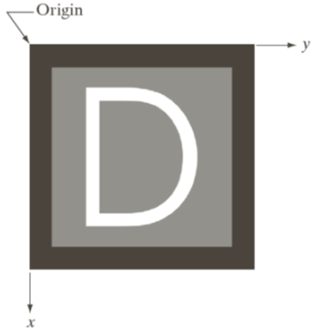
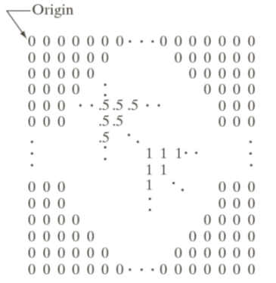
Representing Digital images
Plotted as surface
Visual intensity array
(0..0,5..1) =(black, gray and white)

Slide 19
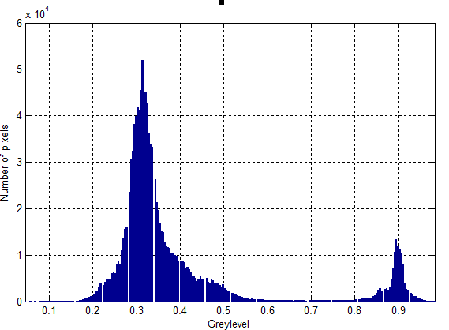
Histograms
Dark pixels
Light pixels

Slide 20
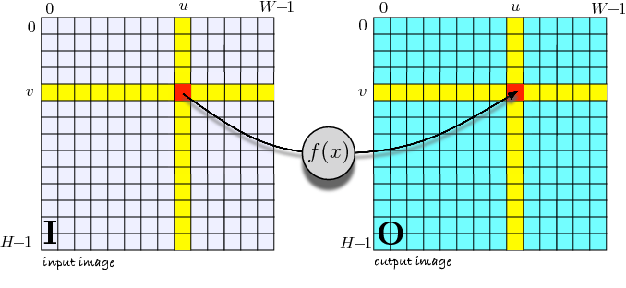
Image Processing
Pixel by pixel processing
Taking an input image I, pumping every pixel in a function f,
and put the result to an output image O.

Slide 21
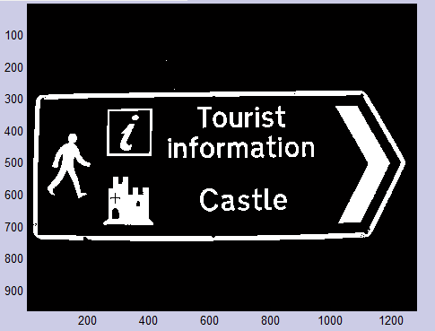
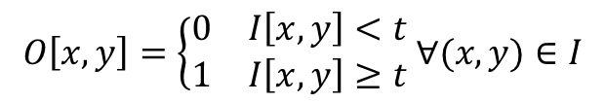
Thresholding
If pixelvalue < t
then pixelvalue := 0;
If pixelvalue >= t
then pixelvalue := 1;
$$O\left[x,y\right]=\left\{\begin{matrix}0 & I\left[x,y\right]<t \\ 1 & I\left[x,y\right]≥t\end{matrix} ∀(x,y)∈I\right.$$
t = threshold value
x,y = pixelcoordinate
Calculating the threshold value t… ?

Slide 22
Calculating the threshold value t….
Dark pixels
Light pixels
t

Slide 23
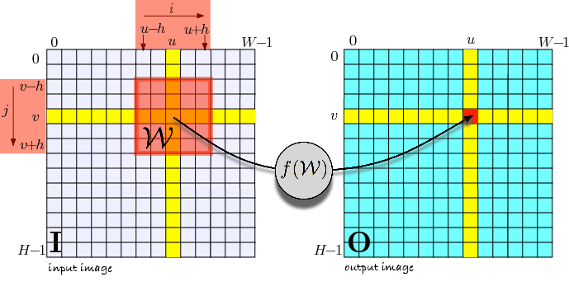
Image Processing
Spatial operations

Slide 24
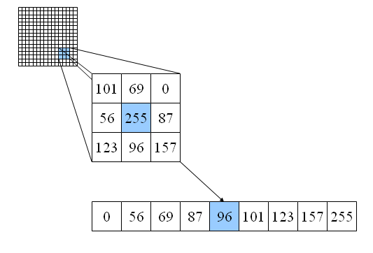
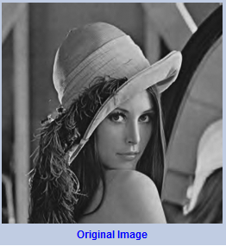
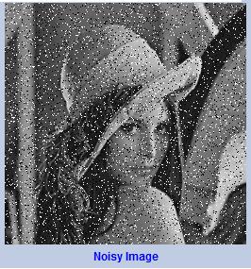
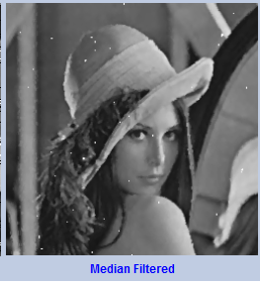
Image Processing
smoothing
W
Example spatial operations
Median filter.

Slide 25
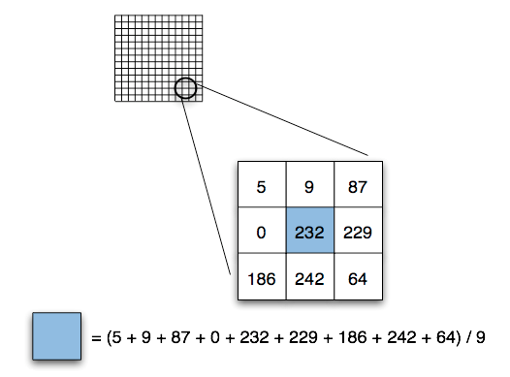
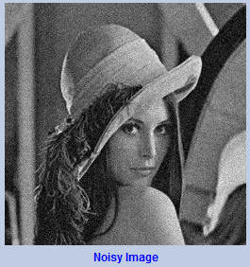
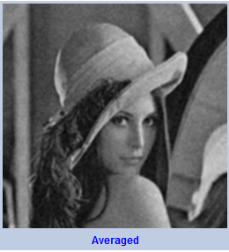
Image Processing
smoothing
Example spatial operations
Mean filter.
117

Slide 26
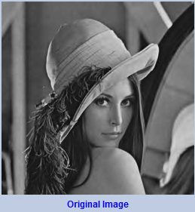
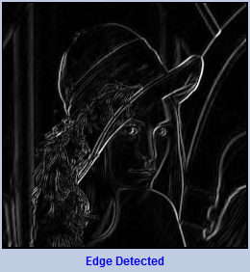






Image Processing
edge detection
A very important spatial operation
calling convolution*
-1
0
1
1
2
1
$$s_{x}=$$
-2
0
2
$$⊗Image$$
$$s_{y}=$$
0
0
0
$$⊗Image$$
-1
0
1
-1
-2
-1
Horizontal changes
Vertical changes
$⊗$ = convolution

Slide 27


Image Processing
?

Slide 28









Image Processing
a blob is a region of a digital image in which some properties are constant or vary within a prescribed range of values; all the points in a blob can be considered in some sense to be similar to each other.
$$\left[x,y\right]=find \left(Image>0\right)$$
$$x_{min}=\min\left(x\right);$$
$$x_{max}=\max\left(x\right);$$
$$y_{min}=\min\left(y\right);$$
$$y_{max}=\max\left(y\right);$$
$$x_{min}=150$$
$$x_{max}=250$$
$$x_{center}=250−150;$$
$$y_{min}=150$$
$$y_{center}=250−150;$$
$$y_{max}=250$$

Slide 29


Image Processing
More Blobs

Slide 30


Slide 31




Moments
an image moment is a certain particular weighted average (moment) of the image pixels, intensities, or a function of such moments, usually chosen to have some attractive property or interpretation.
$$m_{pq}=\sum_{(x,y)∈I}{x^{p}y^{q}I[x,y]}$$
$$\left(p and q\right)=the order of the moment$$
0 0 order; $\left(p=q=0\right) moment of an image is$
$$m_{pq}=\sum_{(x,y)∈I}{I[x,y]}$$
which is the number of pixels (or Area)
OpenCV:
http://docs.opencv.org/modules/imgproc/doc/structural_analysis_and_shape_descriptors.html?highlight=moments#moments
See also document Simple ImageAnalysis by Moments on SharePoint

Slide 32



Moments
The centroid or centre of mass or gravity is given by
$$x_{c}=\frac{m_{10}}{m_{00}}, y_{c}=\frac{m_{01}}{m_{00}}$$
% im = image
>> m00=mpq(im,0,0)
m00 =
7845
>> m01=mpq(im,0,1)
m01 =
1569000
>> m10=mpq(im,1,0)
m10 =
1569000
>> m01/m00
ans =
200
>> m10/m00
ans =
200
$$y_{c}$$
$$x_{c}$$
Note: these functions are Matlab functions

Slide 33


Moments
exercise
A blob has the following moments:
m00 = 6.342.
m01 = 756.492.
m10 = 2331.673.
$$x_{c}=\frac{m_{10}}{m_{00}}, y_{c}=\frac{m_{01}}{m_{00}}$$
What is the area of the blob?
If the blob was circular what is the diameter?
What is the centroid of the blob?
Exercise solution:
The Area = 6.342 pixels
If the blob was circular then the Area would be $π{ r}^{2}$ giving a diameter of
90 pixels. $\frac{6342}{π}=r^{2}=2018.72→diameter=2r=89.86 pixels$
Centroids are: $x_{c}=\frac{2331673}{6342}=367,7$ (368)
$y_{c}=\frac{756492}{6342}=119,3$ (119)

Slide 34
Readings (selfstudy)
Learning OpenCV Computer Vision with the OpenCV Library. Gary Bradski & Adrian Kaehler ISBN: 978-0-596-51613-0
Chapter 1 up to 4
See also document: “IntroductionOpenCV.pdf” on SharePoint

Slide 35



Some examples with OpenCV
Assignment for next week
Example1 (Sharepoint)
C++ Interface
Example 2 (Sharepoint)
Drawing shapes and texts

Slide 36
OpenCV
OpenCV Wiki
http://opencv.willowgarage.com/wiki/Welcome
Installation
OpenCV is integrated in ROS…..(tricky) otherwise
http://opencv.willowgarage.com/wiki/InstallGuide#GetOpenCV
Tutorials
A lots available on internet
http://www.pages.drexel.edu/~nk752/tutorials.html
Assignment for next week: Configure OpenCV in ROS and execute example 1 and example 2 of SharePoint

Slide 37
End of MINES-VIS 1

